Slide 1
Deep Learning for Data Scientists
Antonio Rueda-Toicen
Data Science Retreat
August 2023

Slide 2
About me
Senior Data Scientist at Vinted
Background in academia (computer science and bioengineering)
Organizer of the Berlin Computer Vision Group
Arepa-lover (try them, they’re awesome)

Slide 3
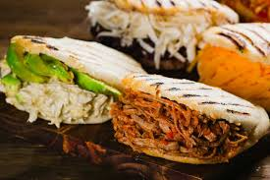
Fig 1: Arepas

Slide 4

https://www.meetup.com/Berlin-Computer-Vision-Group/

Slide 5
Agenda
Intro to deep learning
DL in the machine learning project-cycle
What is DL and why should we use it?
Neural networks
Perceptrons
The feedforward pass
Backpropagation
Activation functions
Stochastic gradient descent
Convolutional neural networks
Data augmentation
Residual networks (ResNet)
Binary vs multiclass classifiers
Transfer learning and embeddings
Our goal: build a cats vs dogs image classifier in PyTorch

Slide 6
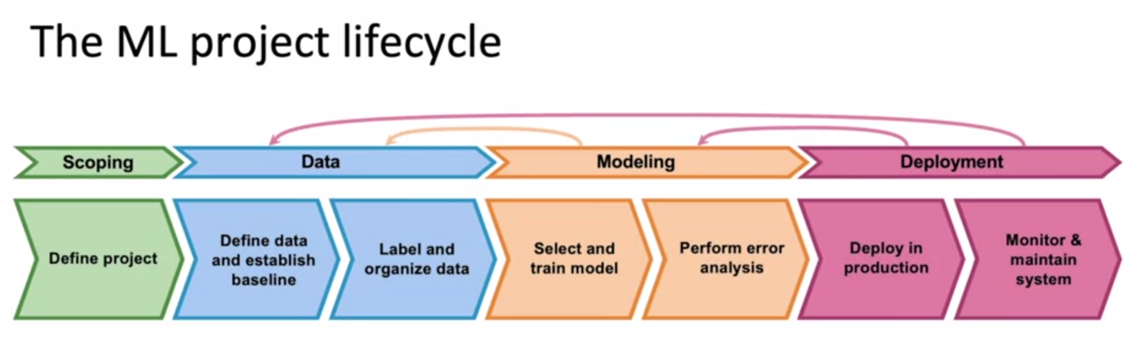
From Andrew Ng’s Intro to ML in Production

Slide 7
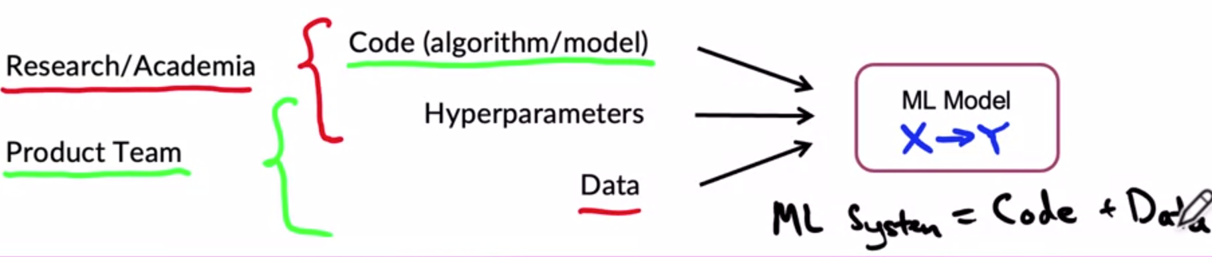
The data driven-approach to ML
From Andrew Ng’s Intro to ML in Production

Slide 8
Knowing the jargon
Model aka network aka architecture (although a fine-grained distinction exists here with respect to training)
Weight aka parameter aka connection strength
Hyperparameter
Capacity
Loss aka cost aka error function
Error rate aka 1 - accuracy
Sensitivity aka recall
Activation function
Transfer learning
Epoch vs Batch
Convolution, receptive field
Linear aka “Dense”aka ‘fully connected’ layer
Notes:
a function that maps its input (a real-valued vector) to an output value (a single scalar value), although “spiking neural networks” output vectors
https://en.wikipedia.org/wiki/Perceptron
Interesting bit: The perceptron of optimal stability, together with the kernel trick, are the conceptual foundations of the support vector machine.

Slide 9
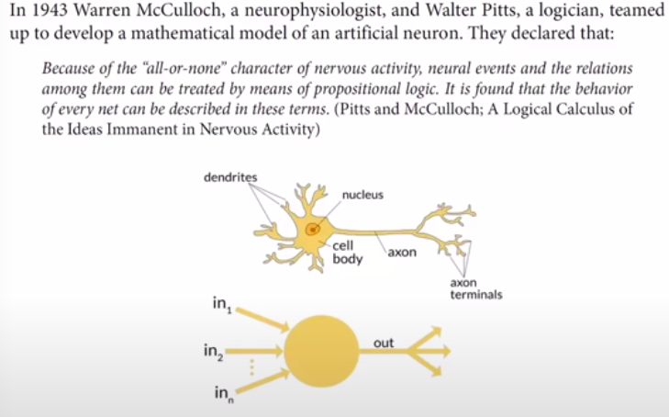
What is an artificial neural network?
Artificial “neurons” are also called
“processing units”
Recommended read: “The Man Who Tried to Redeem the World with Logic”
Notes:
a function that maps its input (a real-valued vector) to an output value (a single scalar value), although “spiking neural networks” output vectors
https://en.wikipedia.org/wiki/Perceptron
Interesting bit: The perceptron of optimal stability, together with the kernel trick, are the conceptual foundations of the support vector machine.

Slide 10
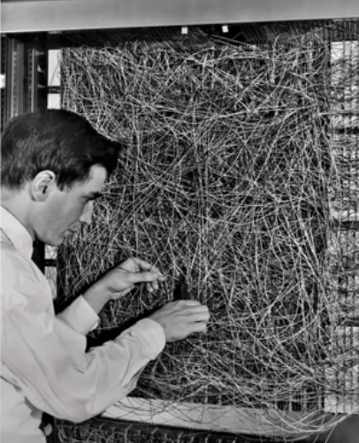
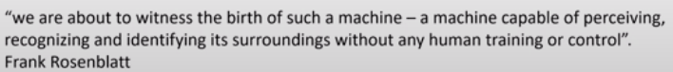
What is an artificial neural network?
Image: Frank Rosenblatt with the Mark I Perceptron at Cornell University (1961)
Notes:
a function that maps its input (a real-valued vector) to an output value (a single binary value):
https://en.wikipedia.org/wiki/Perceptron
Interesting bit: The perceptron of optimal stability, together with the kernel trick, are the conceptual foundations of the support vector machine.

Slide 11

What is deep learning?
Notes:
https://en.wikipedia.org/wiki/Perceptron
Interesting bit: The perceptron of optimal stability, together with the kernel trick, are the conceptual foundations of the support vector machine.

Slide 12

Stir the pile

Slide 13
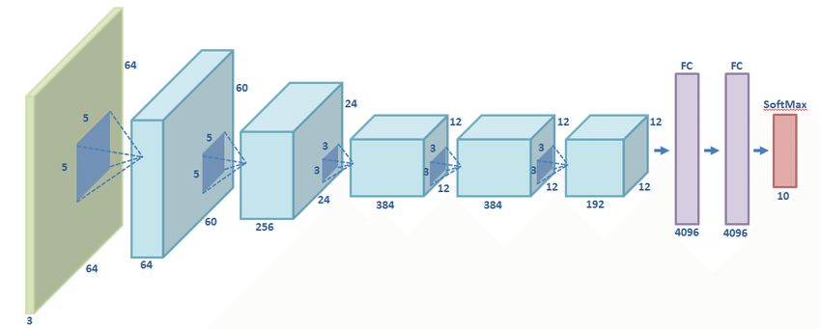
Different network architectures represent different ways to ‘stir the pile’
Architecture of the Alexnet network

Slide 14
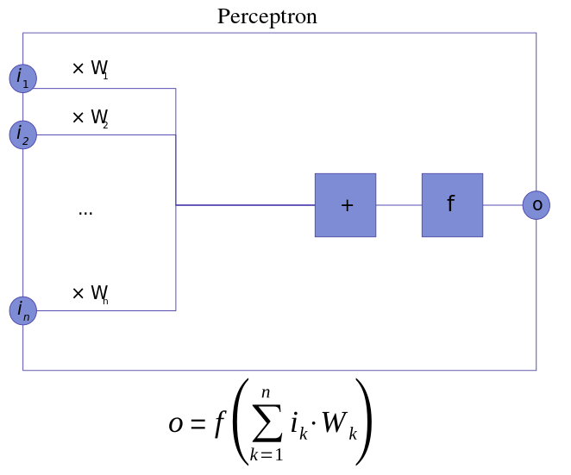
What is a perceptron?

Slide 15
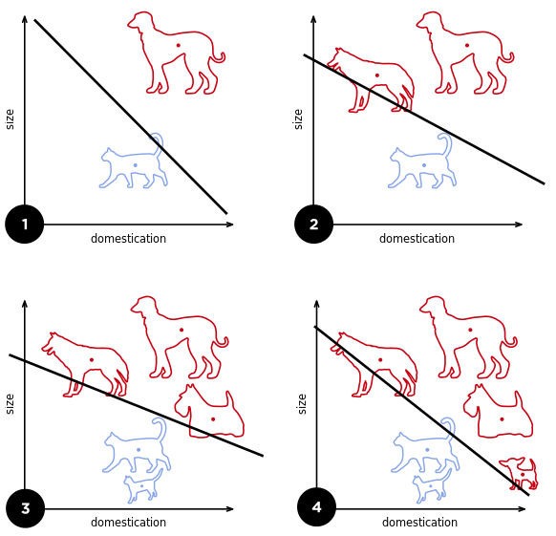
What is a perceptron?
A fine-grained discussion about the differences in logistic regression and the perceptron algorithm

Slide 16
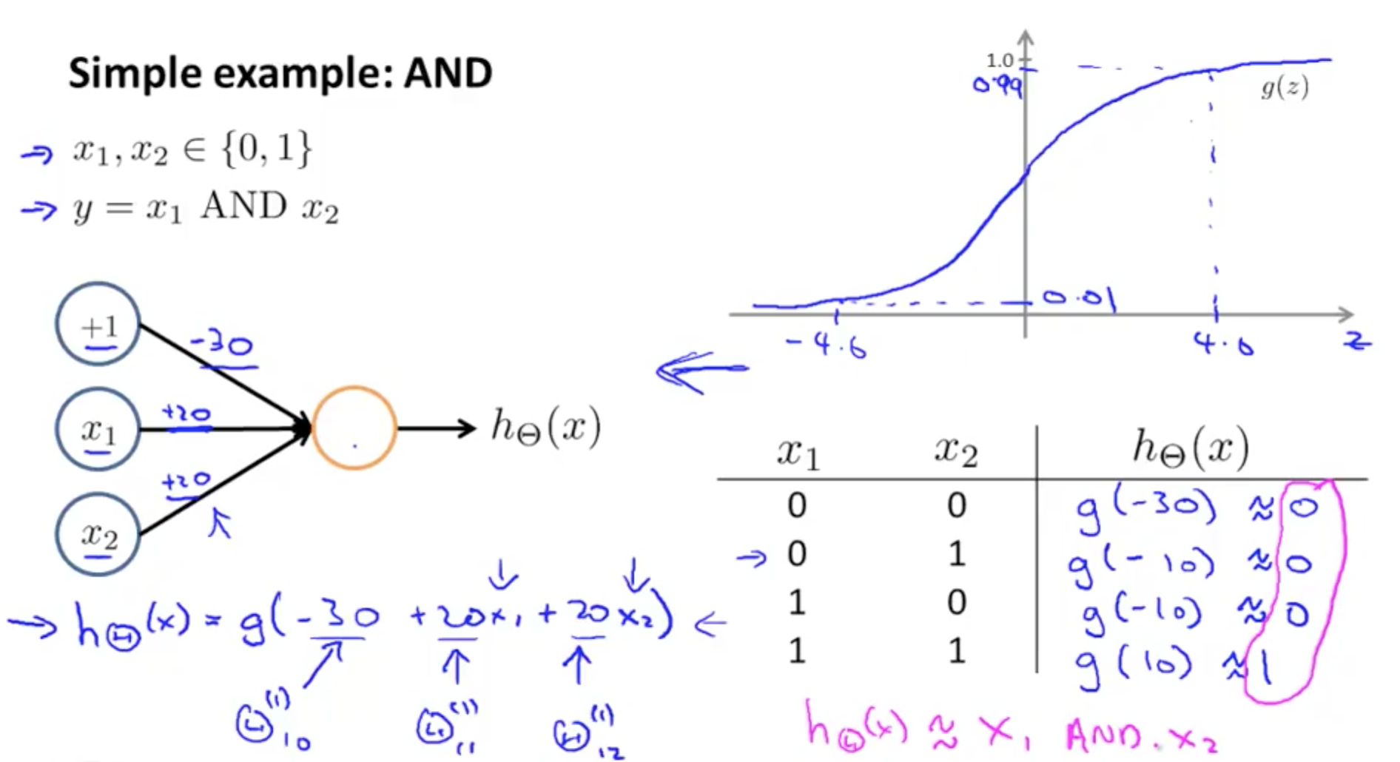
What does a neural network ‘learn’?
It learns “weights” aka “parameters” aka “connection strengths” that minimize a measure of error (aka “loss” aka “cost”) function given a set of training inputs x (aka “a dataset”)

Slide 17
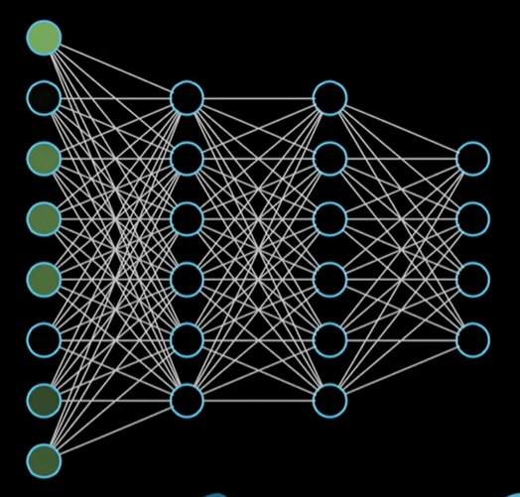
Multilayer perceptrons

Slide 18
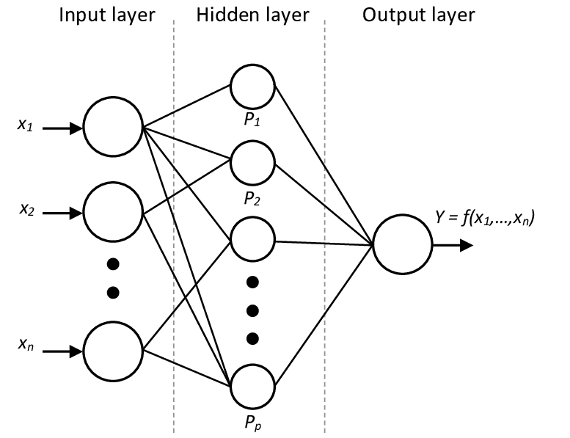
Hidden layers

Slide 19
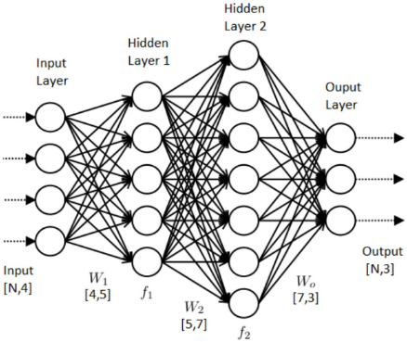
Hidden layers

Slide 20
Observation: the term ‘deep learning’ is pure hype
Most of the techniques for “deep learning” have been around for at least 50 years
50 years if we count the invention of computation graphs for backpropagation
80 years if we count the first neural network with manually set weights
60 years if we count the invention of the perceptron
‘Deep learning = new AI’ became a thing when people started using neural networks to win the ImageNet challenge about 10 years ago
This rebranding and popularization came mainly through four academic labs: Hinton’s, LeCun’s, Bengio’s and Schmidhuber’s
The real breakthrough came not from new techniques but from more computing power (GPUs)
Deep Learning does not do anything that linear and/or logistic regression cannot do
Think of deep learning as ‘regression on steroids’ and ‘fancy curve fitting’
‘Deep Learning’ does not understand causality, it only picks on correlations

Slide 21
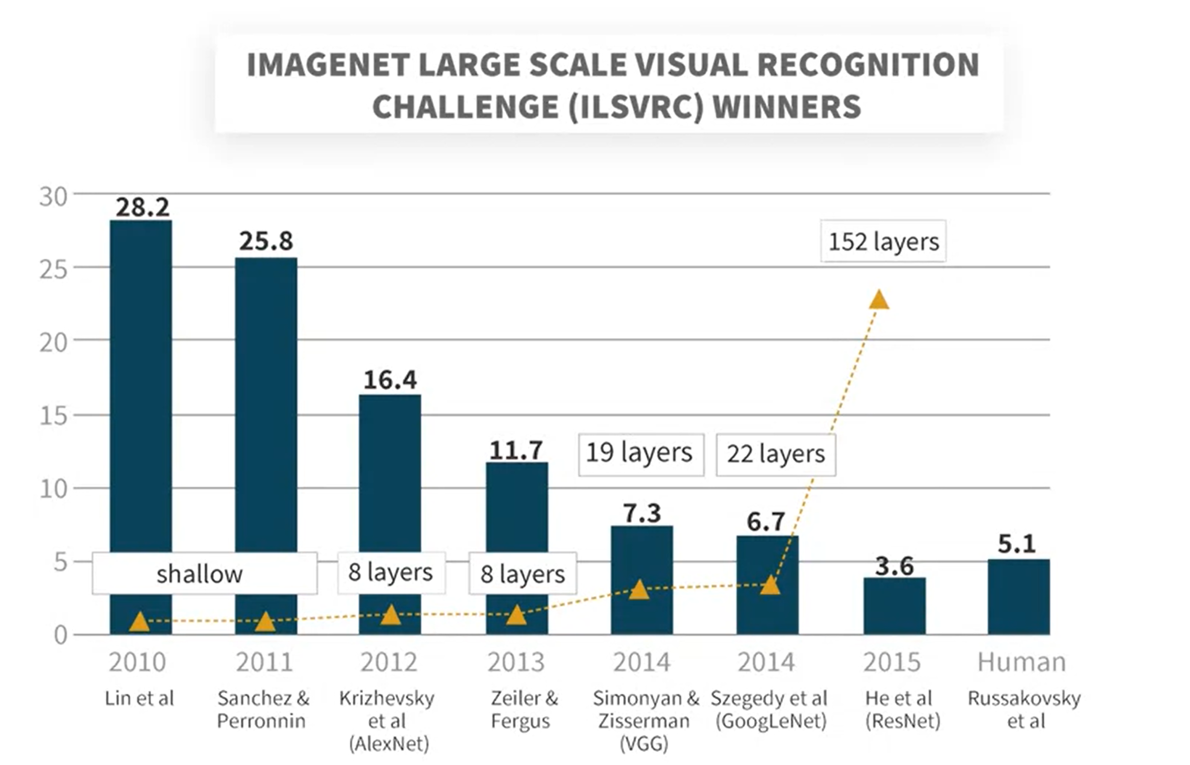
Notes:
Imagenet is the image classification challenge that made deep learning popular

Slide 22
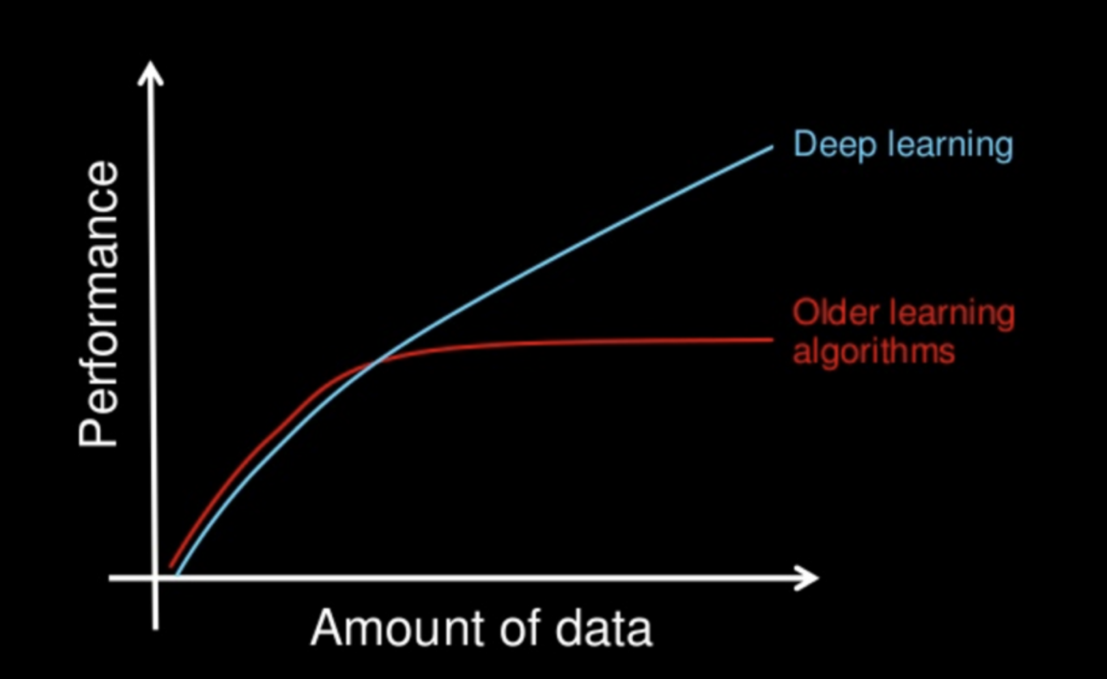
Why do we use deep learning?
Disclaimer: the No Free Lunch Theorems explain why this graph might be hype, although things like the current GPT experiments show promise
Notes:
a function that maps its input (a real-valued vector) to an output value (a single binary value):
https://en.wikipedia.org/wiki/Perceptron
Interesting bit: The perceptron of optimal stability, together with the kernel trick, are the conceptual foundations of the support vector machine.

Slide 23
Applications of deep learning
Computer vision: image classification, object detection, segmentation, image description, image generation, satellite and drone image analysis
Natural Language Processing: translation, text and DNA sequence prediction, text generation
Audio understanding, audio generation, lip reading
Playing games, finding optimal strategies (when paired with reinforcement learning)
Any system that requires the finding of significant correlations or patterns/”intuitions” in the data, i.e. the ‘thinking fast’ systems referred by Daniel Kahneman in his famous book.
Notes:
a function that maps its input (a real-valued vector) to an output value (a single binary value):
https://en.wikipedia.org/wiki/Perceptron
Interesting bit: The perceptron of optimal stability, together with the kernel trick, are the conceptual foundations of the support vector machine.

Slide 24
Why do we use deep learning?
Deep neural networks are universal function approximators
This means that given the right architecture and training, they can compute everything that’s computable, just like a Universal Turing Machine
In practice this means that deep networks are very good at finding very sophisticated decision boundaries (aka “curve fitting”)
Finding the function means the finding architecture and or training of the neural network
It’s fair to call deep neural networks “linear regression on steroids”
Deep neural networks pick hidden correlations in the data, but most architectures don’t pick on causality (current research topic)
Notes:
a function that maps its input (a real-valued vector) to an output value (a single binary value):
https://en.wikipedia.org/wiki/Perceptron
Interesting bit: The perceptron of optimal stability, together with the kernel trick, are the conceptual foundations of the support vector machine.

Slide 25
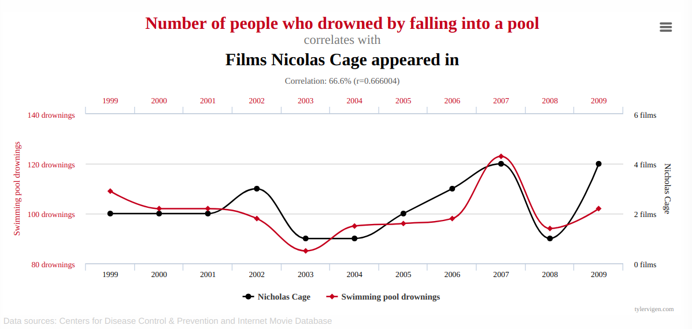

Slide 26
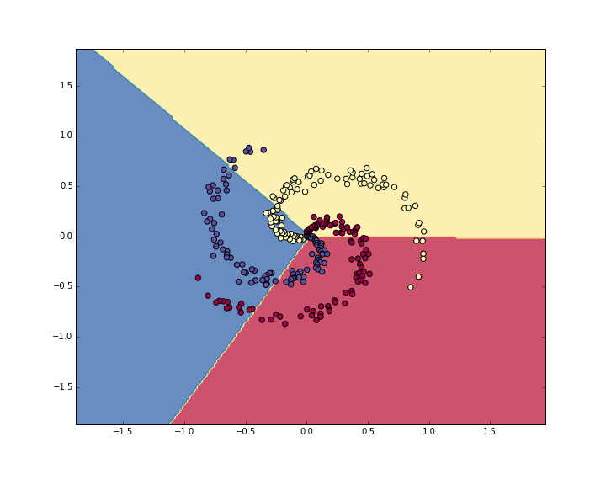
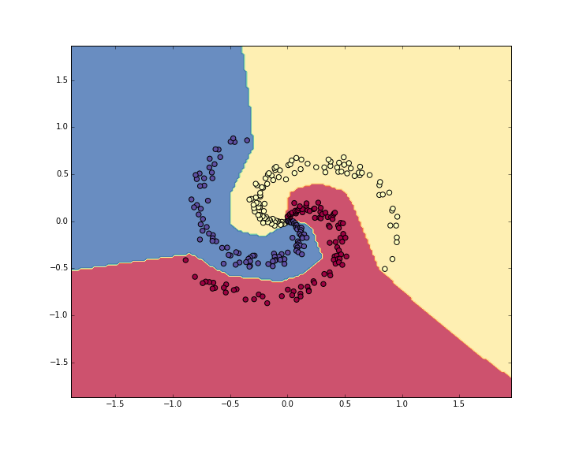
‘Deep learning’ is the art of making squiggly functions
Squiggly function = ‘sophisticated decision boundary’
More weights and non linear activations ~ more squiggly boundaries

Slide 27
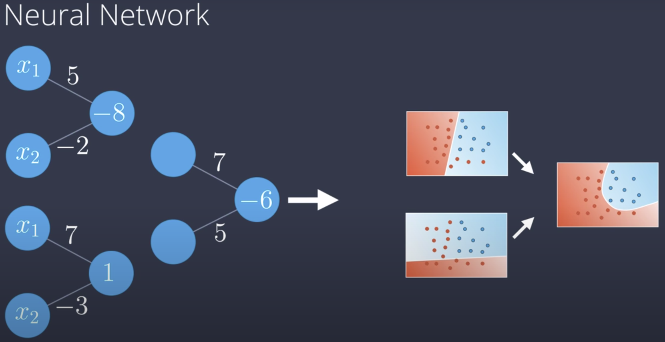
Learning non-linearities
How neural networks learn non-linearities

Slide 28
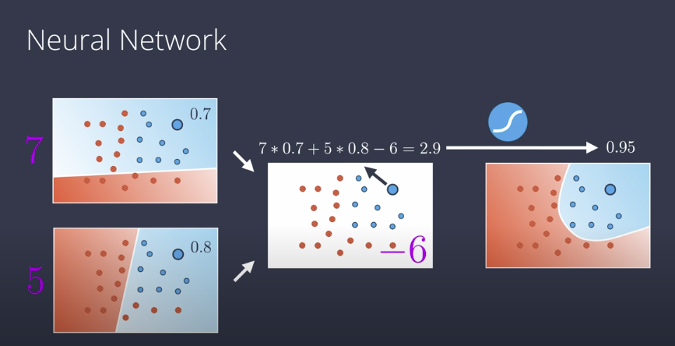

Slide 29
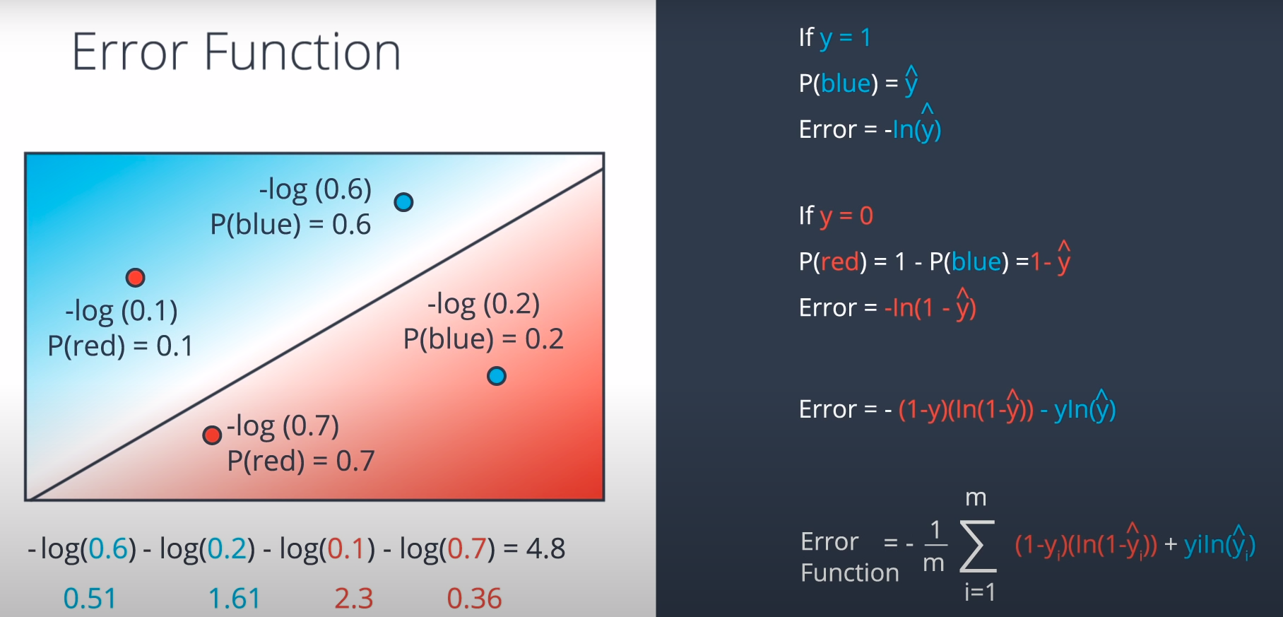
The loss function
Q: Which of these points have higher cross entropy?
Notes:
https://classroom.udacity.com/courses/ud188/lessons/b4ca7aaa-b346-43b1-ae7d-20d27b2eab65/concepts/a5711d6e-abc1-41bc-a242-e8c8a9834f72

Slide 30
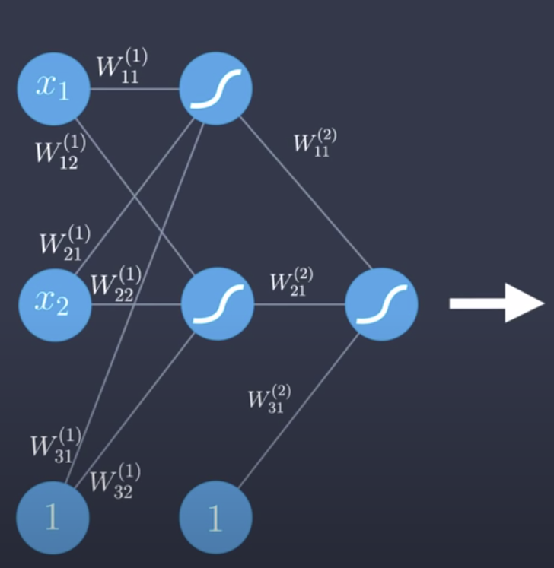
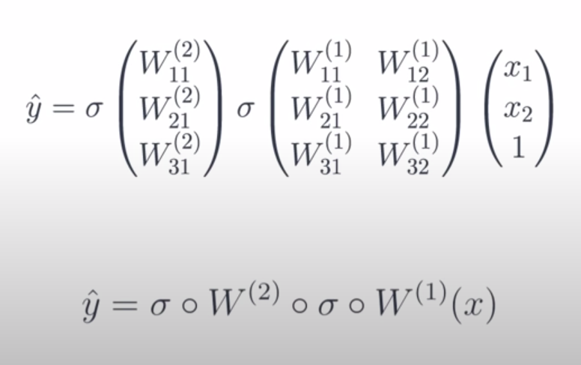
The feedforward pass
Understanding the feedforward pass

Slide 31
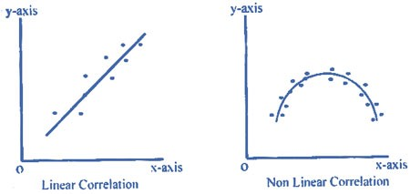
Learning non-linearities
How neural networks learn non-linearities

Slide 32
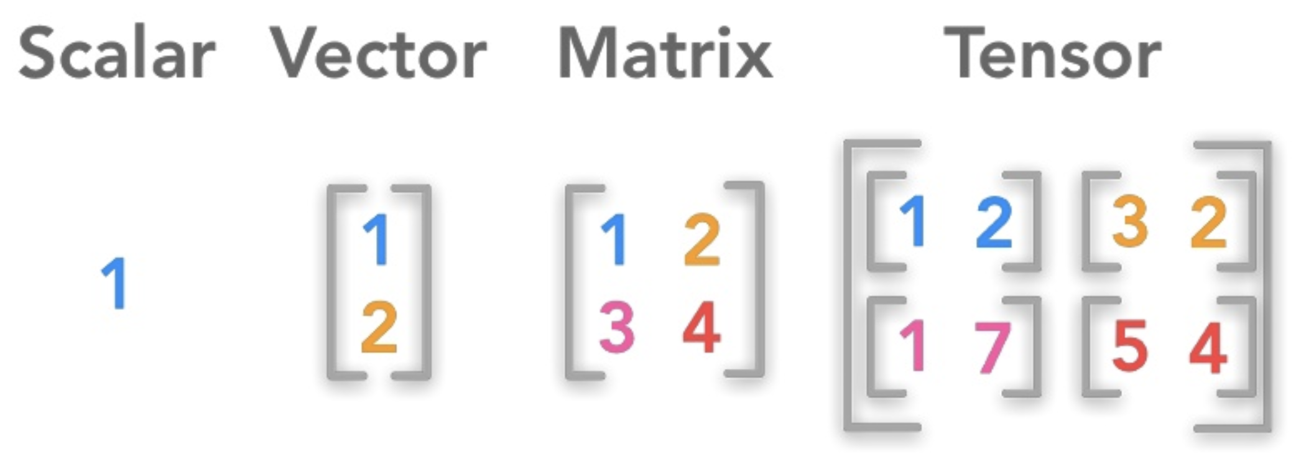
Read: scalars, vectors, matrices, and tensors
Understanding rank terminology

Slide 33
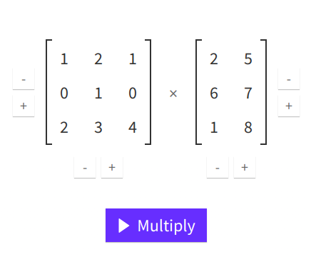
Matrix multiplication
http://matrixmultiplication.xyz/

Slide 34
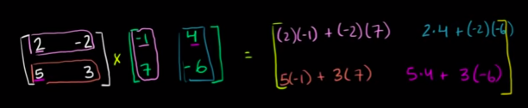
Matrix multiplication
Khan Academy Tutorial

Slide 35
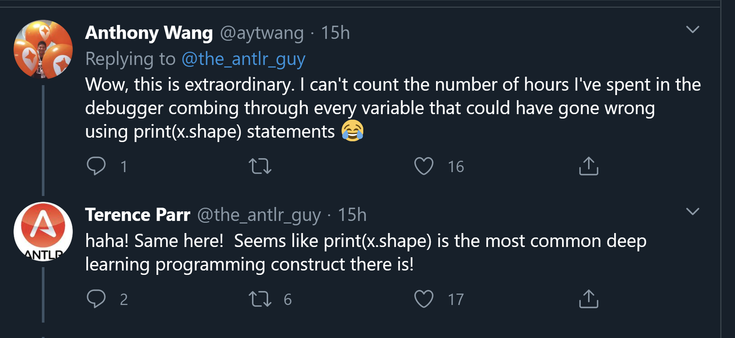
Pay attention to the size of the input

Slide 36
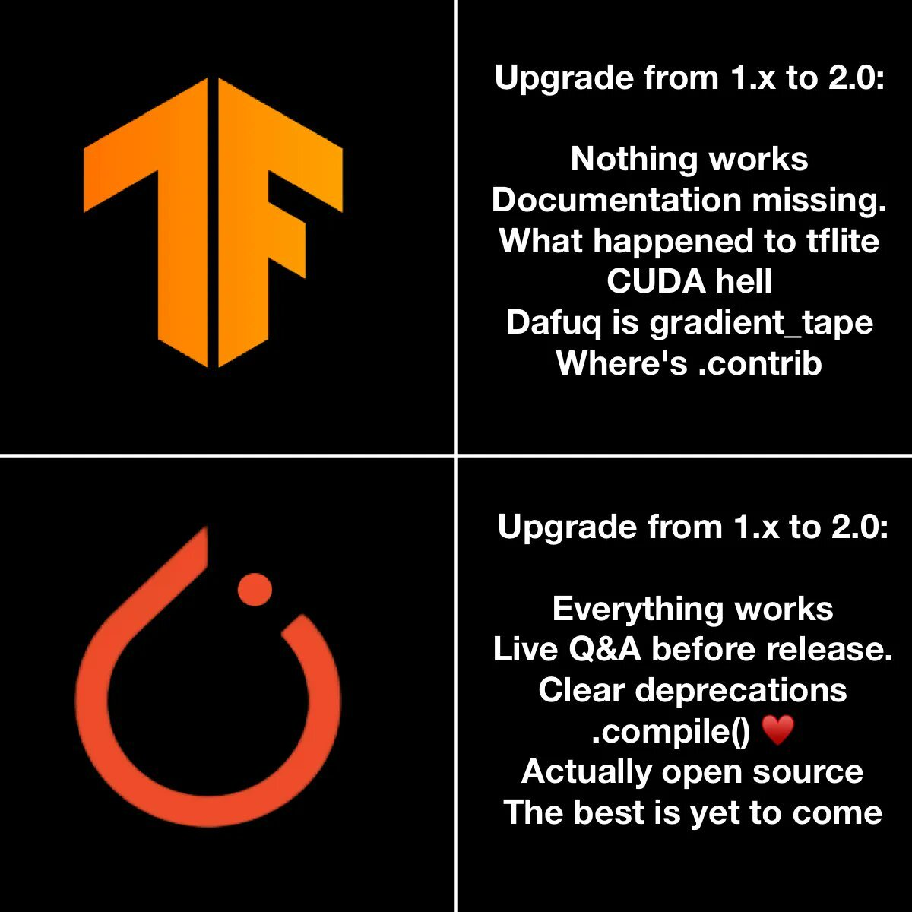

Slide 37
Practice: tensors in Pytorch
Notebook
Solutions
Questions:
Why do we use bias terms?
How is a torch tensor different from a numpy ndarray?
Is a torch tensor always run on a GPU?
What is an in-place operation? How are in-place methods named in Pytorch?
Is the rectifier linear unit a linear or a non-linear function?

Slide 38
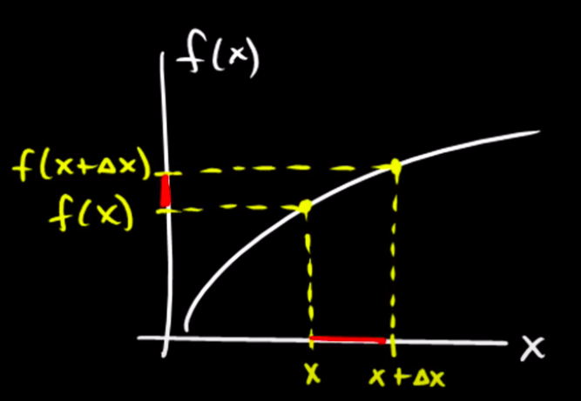
Numerical calculation of derivatives
Numerical derivatives
Numerical and analytic derivatives in Python

Slide 39
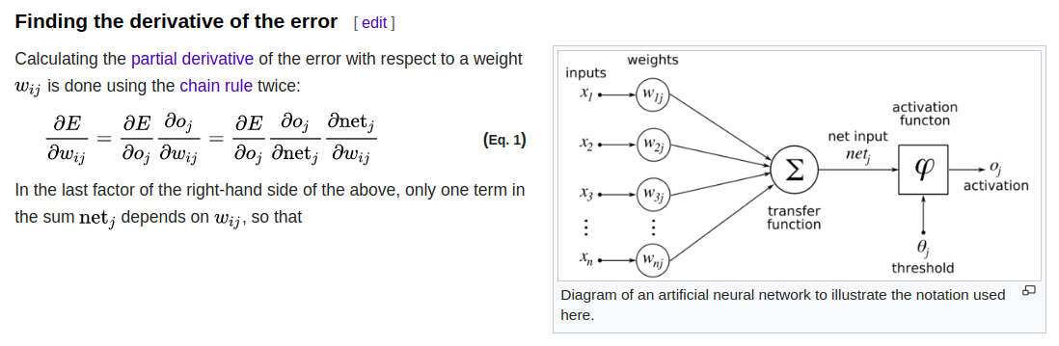
Backpropagation
https://en.wikipedia.org/wiki/Backpropagation
Notes:
https://en.wikipedia.org/wiki/Perceptron
Interesting bit: The perceptron of optimal stability, together with the kernel trick, are the conceptual foundations of the support vector machine.

Slide 40
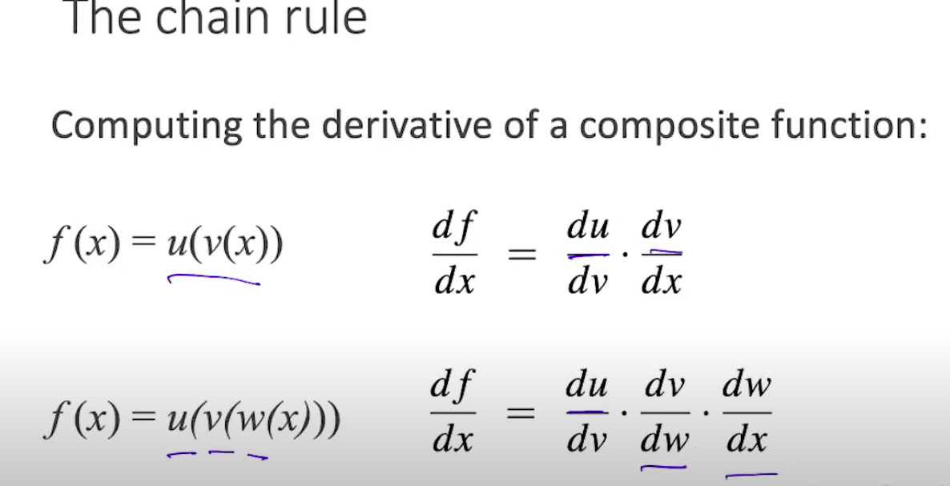

Slide 41
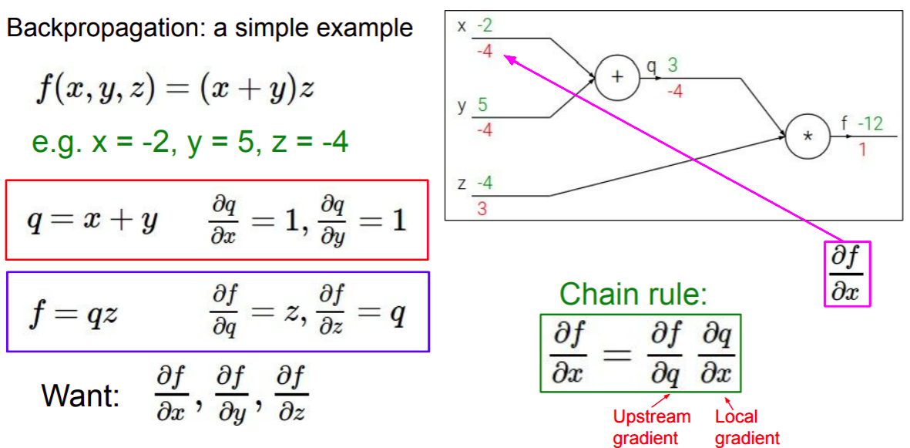
Gradient computation graphs
http://cs231n.stanford.edu/slides/2019/cs231n_2019_lecture04.pdf

Slide 42
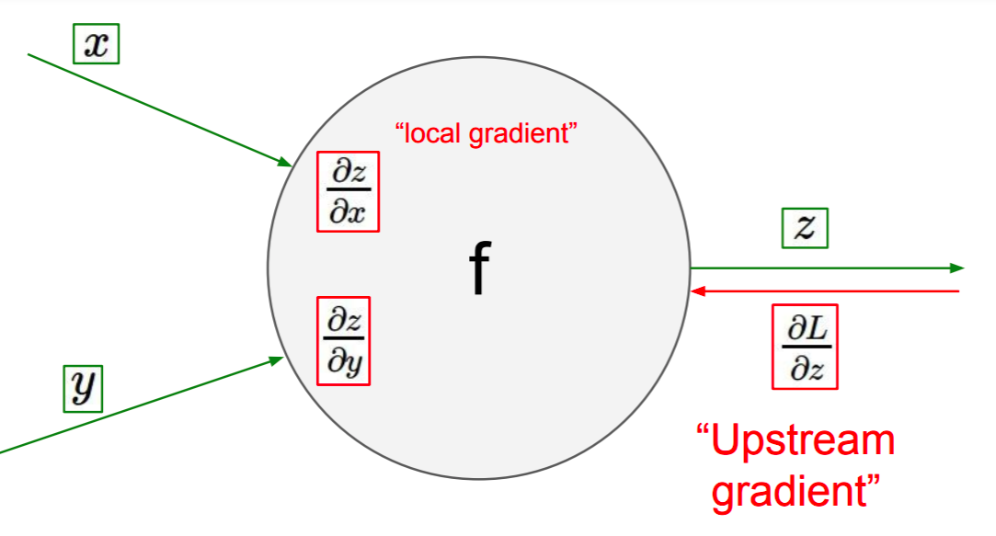
Gradient computation graphs
http://cs231n.stanford.edu/slides/2019/cs231n_2019_lecture04.pdf

Slide 43
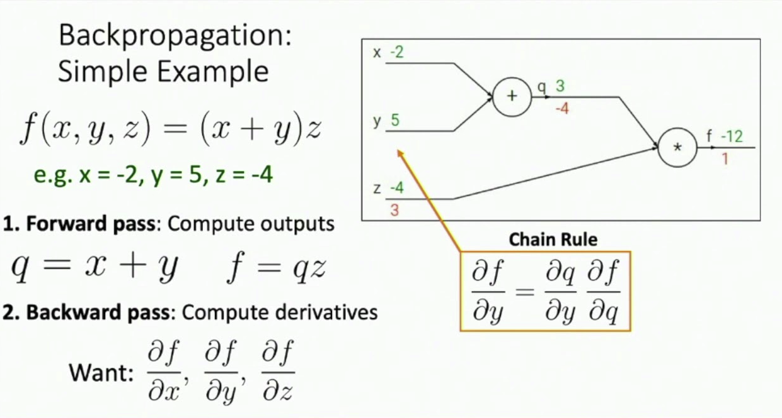
Justin Johnson’s lecture

Slide 44
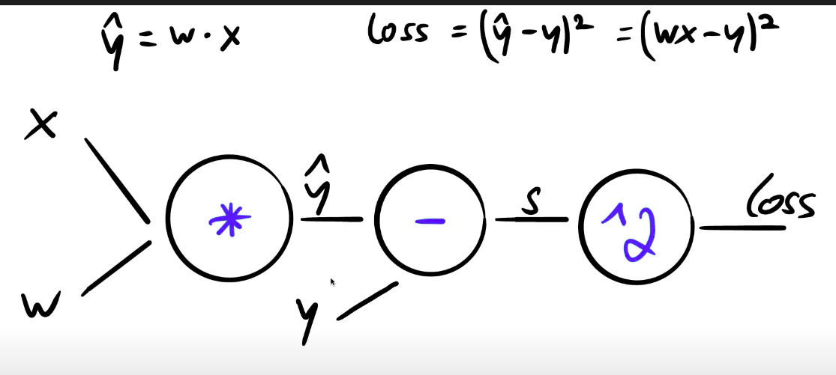

Slide 45
Backpropagation in PyTorch
Watch this (clearest, most practical explanation on backprop ever)
Notebook
Solution
Review questions
What is backpropagation doing?
What needs to happen before we call backward() in PyTorch?
What is the gradient computation graph?
Why is grad_fn changing with every operation done to something involving the weights?

Slide 46
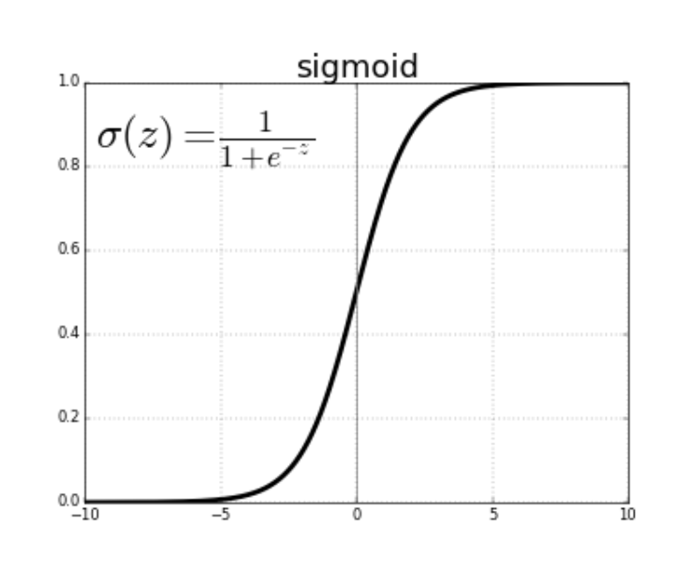
The sigmoid activation function

Slide 47
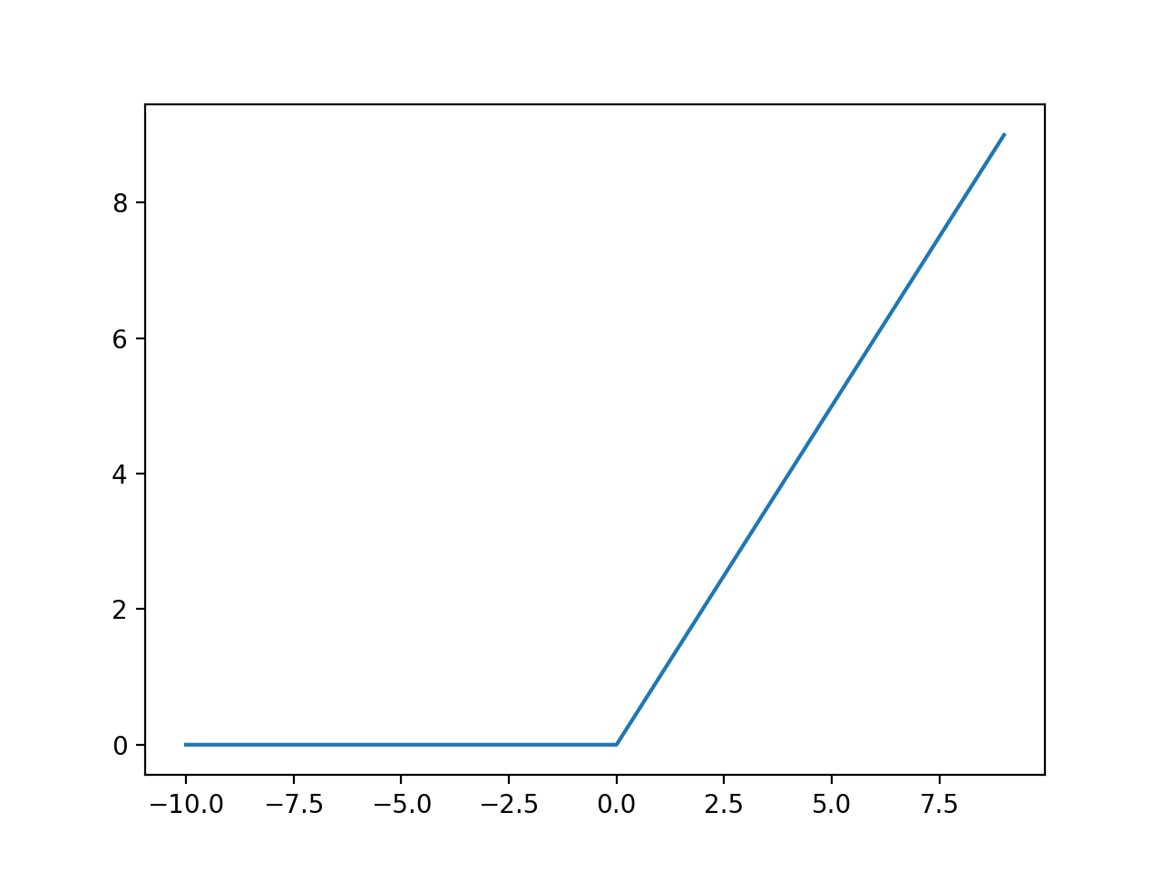
The rectifier linear unit (ReLU) activation function
Notes:
https://machinelearningmastery.com/rectified-linear-activation-function-for-deep-learning-neural-networks/
https://stats.stackexchange.com/questions/333394/what-is-the-derivative-of-the-relu-activation-function

Slide 48
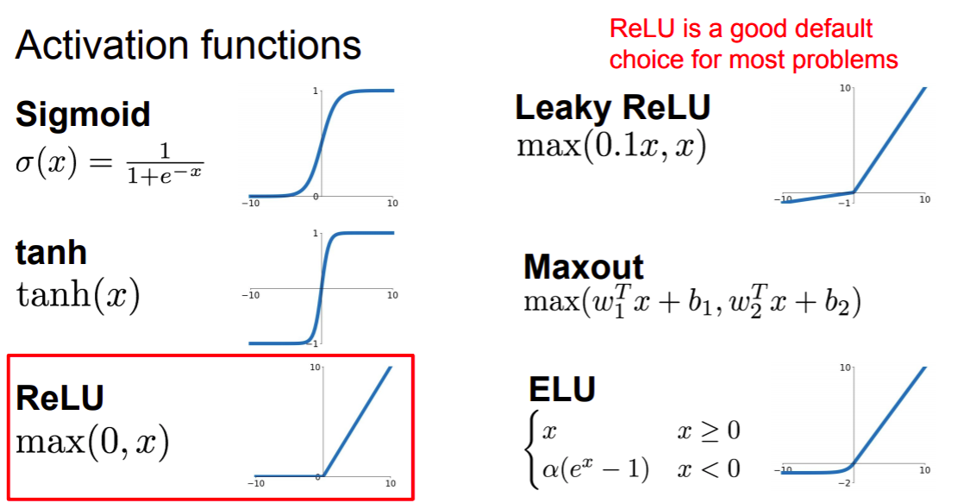
http://cs231n.stanford.edu/slides/2019/cs231n_2019_lecture04.pdf

Slide 49
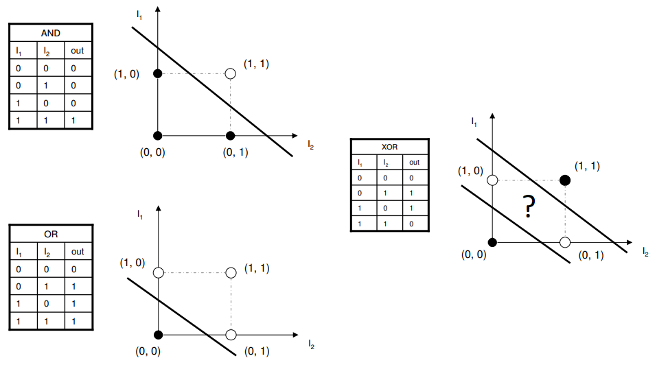
Doing logic with a neural network
Experiments, Solution notebook

Slide 50
Learning non-linearities
https://cs231n.github.io/neural-networks-case-study
Experiment notebook
Q: What happens with large learning rates? What happens with large coefficients for l2 regularization?

Slide 51
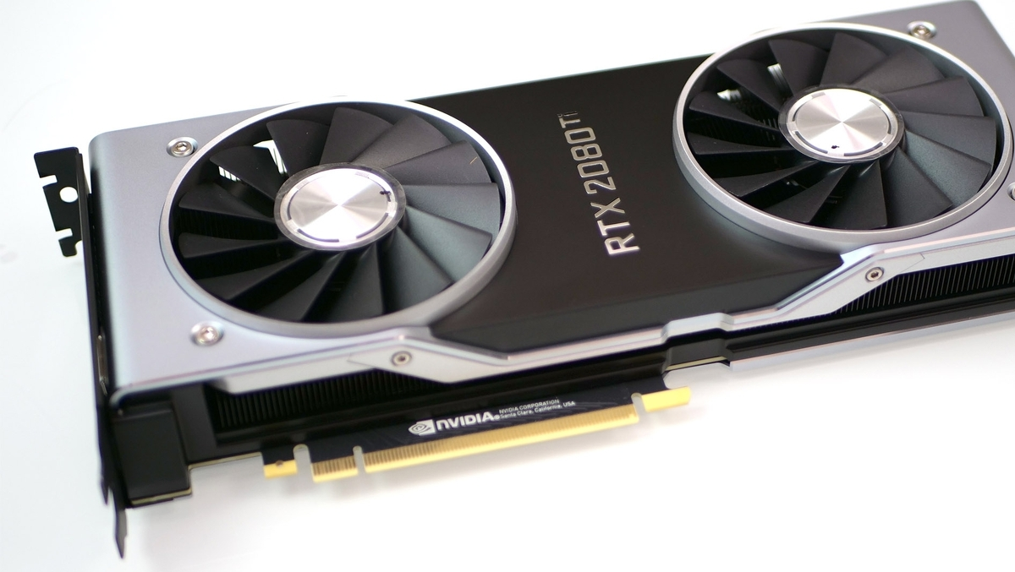
What is a GPU?
Most deep learning libraries require the use of NVIDIA graphical processing units with CUDA capabilities

Slide 52
Why use a GPU for deep learning?
How is a CPU different from a GPU?
More cores!
Why are CPUs less effective for deep learning?
Less cores :(
Notes:
You
https://en.wikipedia.org/wiki/Perceptron
Interesting bit: The perceptron of optimal stability, together with the kernel trick, are the conceptual foundations of the support vector machine.

Slide 53
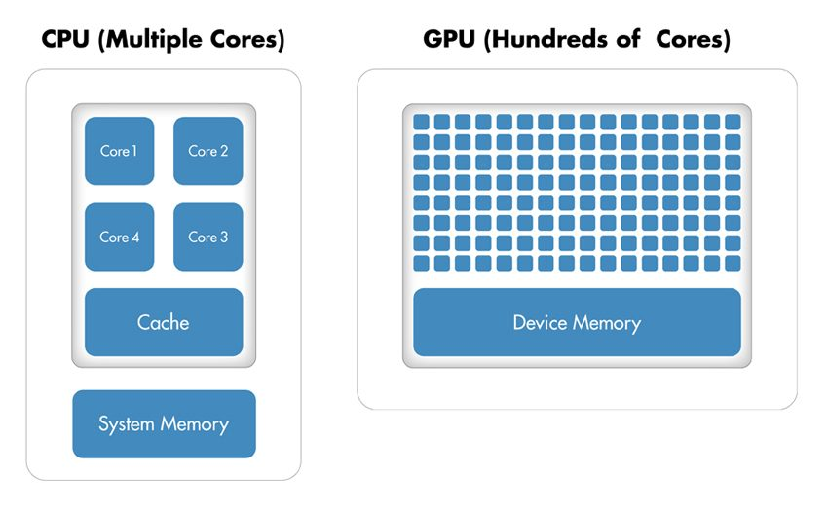

Slide 54
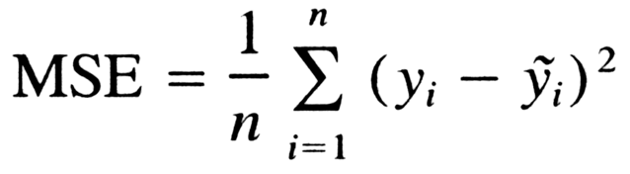
Choose the right loss function for the task
Mean Squared Error is a loss function for regression

Slide 55
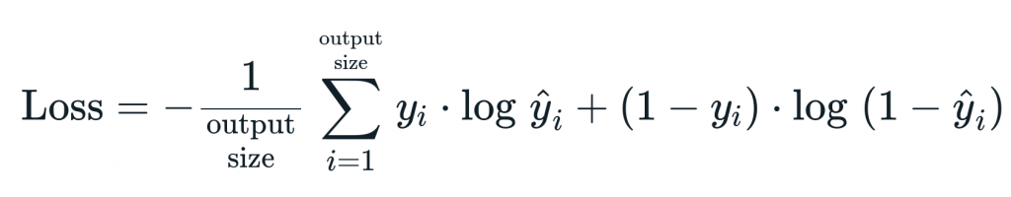
Choose the right loss function for the task
Cross entropy is a function for classification, used interchangeably with negative log-likelihood, here we see it in its binary case

Slide 56
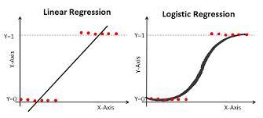

Slide 57
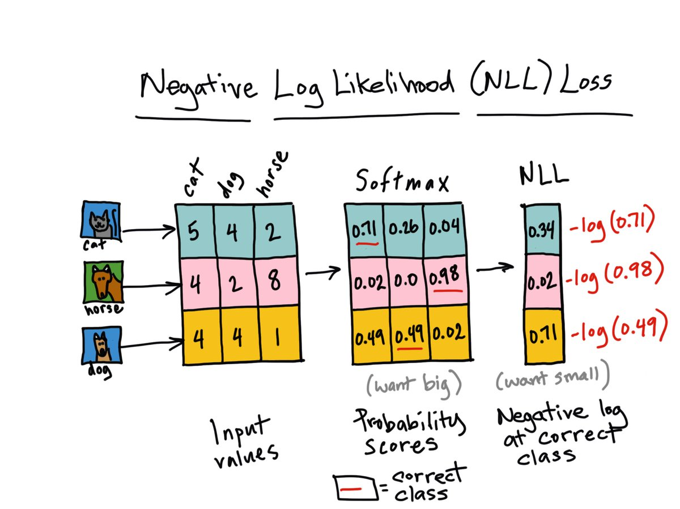
Can we solve this task with logistic regression?

Slide 58
Q: Which loss function should we use for binary logistic regression?
Mean Squared Error
Cross Entropy
Negative log-likelihood (huh? Maybe read this too later.)
Precision & Recall
None of the above

Slide 59
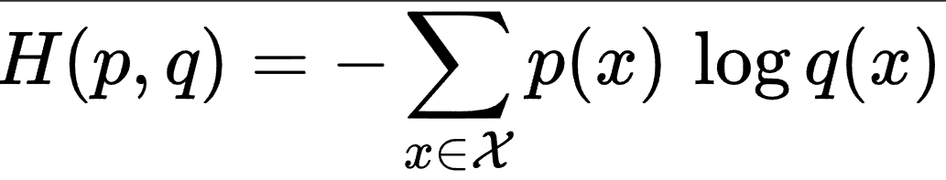
Cross Entropy

Slide 60
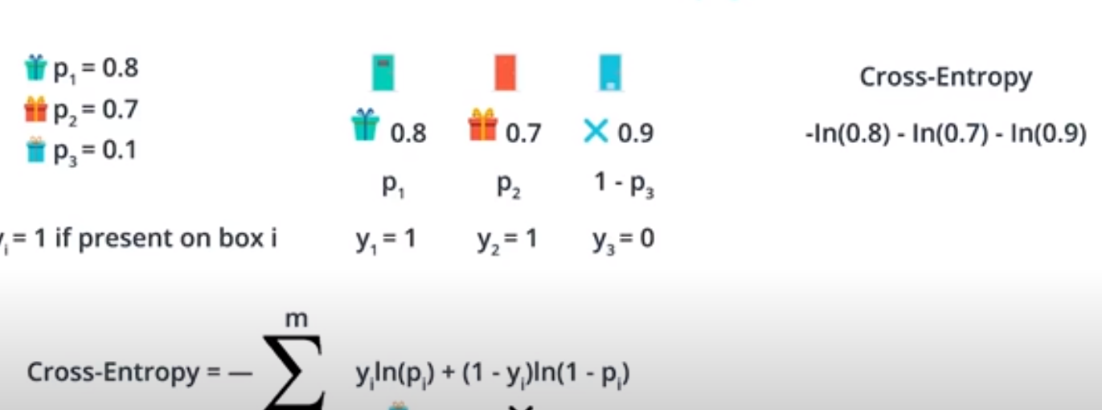
Cross entropy
Explore the Colab notebook

Slide 61
Exercise
Solution
Refer to this tutorial and this discussion

Slide 62
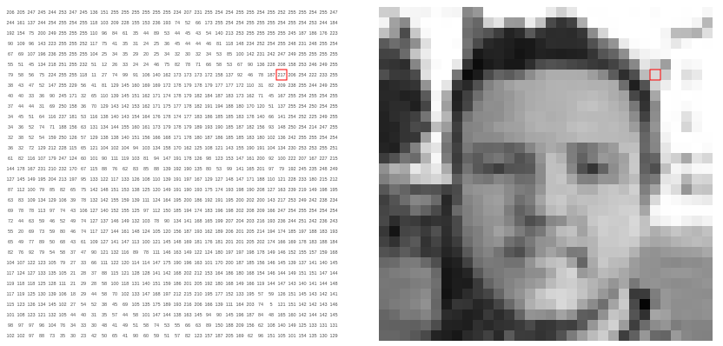
How do computers represent images?
https://setosa.io/ev/image-kernels/

Slide 63
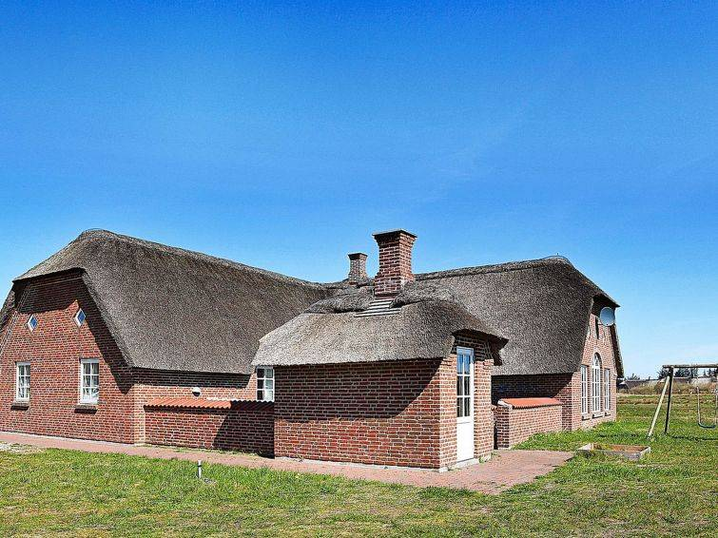

Images as tensors
What a human sees What the computer ‘sees’

Slide 64


Setting up Google Colab

Slide 65

Installing PyTorch
https://pytorch.org/

Slide 66

Gradient descent
https://github.com/fastai/fastbook/blob/master/04_mnist_basics.ipynb

Slide 67

Stochastic gradient descent

Slide 68

Implementing gradient descent

Slide 69


Slide 70

The importance of the learning rate

Slide 71

The importance of the learning rate

Slide 72

Choosing a learning rate

Slide 73


Choosing a learning rate

Slide 74

Weight decay aka lx-regularization
L1 and L2 regularization

Slide 75

The bias vs variance tradeoff

Slide 76

The bias vs variance tradeoff

Slide 77

The bias vs variance tradeoff

Slide 78
Practice: neural networks in PyTorch
Notebook
Solutions
Questions
How do we subclass nn.Module?
What is a subclass?
How many layers do we need to learn non-linear mappings?
What is the purpose of a dataloader?
What is nn.Linear?
What is the purpose of nn.Sequential?
Why would we use OrderedDict to define an architecture?

Slide 79

The Softmax function
https://en.wikipedia.org/wiki/Softmax_function
The softmax activation function in Python

Slide 80
Practice: training in PyTorch
Notebook
Solutions
Questions:
What is a logit (in the context of neural networks)?
How do we turn logits into probabilities?
What criterion should we use if we change nn.LogSoftmax to Softmax? (Read this discussion)
Where do we define the size of the batch?

Slide 81
Performance metrics vs loss functions
A model performance metric measures the quality of predictions in the validation or test sets. Accuracy, precision, recall, specificity, fbeta, f1, and ROC are performance metrics, not loss functions
The default classification error metric in fastai is error_rate = 1 - accuracy
The loss function is used to adjust the weights of the model (through its gradient). The error metric is a report of performance and it can be opposite to the loss function

Slide 82

Understanding the bias vs variance tradeoff in neural network architectures

Slide 83

How long should we train the network?
Until it overfits! (Training loss goes down while validation loss goes up)
This general principle applies to all hyperparameters related to model complexity

Slide 84

The intuition of momentum Exploring momentum’s beta (notebook)

Slide 85

Understanding momentum

Slide 86

The ADAM optimizer
Exponentially moving averages and used to smoothen the trajectory of the gradient descent. Averages are computed across training batches. This optimization algorithm usually trains faster than SGD

Slide 87
Practice: classifying images with fully connected networks
Notebook
Solutions
Questions:
How is the image fed into the network?
Why shouldn’t we use the network’s accuracy as a Pytorch criterion?
What is the optimizer?
How does ADAM differ from Stochastic Gradient Descent? How are they similar?
What is the lr parameter that we pass to the optimizer?
Why do we pass model.parameters() to the optimizer?

Slide 88
Convolutional Neural Networks
CNNs vs multilayer perceptrons

Slide 89

Image Classification
Outdoor
Building
Snow
what we see

Slide 90

Image Classification
Outdoor
Building
Snow? Do we care about snow?
Enough of these images need to be shown to the algorithm
what the computer “sees”

Slide 91

Defining image taxonomies
Bedroom
Terrace
Desk
Vegetation
Do we have enough images
with these things?

Slide 92

Labels for hard cases
Should we have
added ‘neon lights’ to our
taxonomy?
How many of these things
we have?
Should we invest effort
on this?
Stacks of binary models
are appropriate for this
problem
Notes:
Wall? Light? Party?

Slide 93

Hot Dog not a Hot Dog
https://www.youtube.com/watch?v=vIci3C4JkL0

Slide 94

What is a convolution filter?
https://github.com/fastai/fastbook/blob/master/13_convolutions.ipynb

Slide 95

What is a convolution filter?
https://setosa.io/ev/image-kernels/

Slide 96

What is a convolution filter?
https://setosa.io/ev/image-kernels/

Slide 97

What is a convolution filter?
Understanding the output of convolutional layers

Slide 98

What is a convolution filter?
Visualizing convolution kernels

Slide 99

What is a convolution filter?
Convolution of 3x3 and stride = 1 without padding
Effect: the output loses one pixel on each dimension

Slide 100

What is a convolution filter?
Convolution of 3x3 and stride = 1 padded with zeros
Effect: the output preserves original image size

Slide 101

What is a convolution filter?
Convolution of 3x3 and stride = 2 padded with zeros
Effect: the output is downsampled to about half its size
Activity: Conv2D in Pytorch (Colab notebook)

Slide 102

Experiment: finding edges with convolutions
Finding edges with convolution kernels

Slide 103

Pooling

Slide 104

CNN architectures

Slide 105

Dropout regularization

Slide 106
Practice: Inference and validation
Notebook
Solutions
Saving models notebook
What are the differences between a validation set and a test set? Could you change the notebook use sklearn’s train_test_split to create new validation and test sets?
Does increasing the amount of dropout increase the bias or the variance of the network?
If the training loss is lower than the validation loss is the network overfitted or underfitted?
Why do we want to use torch.nograd() when evaluating the network?
Experiment: try adding a ‘save model’ functionality to P5, implement patience

Slide 107

CNN architectures

Slide 108

CNN architectures

Slide 109

CNN architectures

Slide 110

CNN architectures

Slide 111

CNN architectures
Notes:
nn.Conv3D

Slide 112


Slide 113

Normalizing images
https://pytorch.org/docs/stable/torchvision/transforms.html#transforms-on-torch-tensor
Notes:
Normalize does the following for each channel:
image = (image - mean) / std
The parameters mean, std are passed as 0.5, 0.5 in your case. This will normalize the image in the range [-1,1]. For example, the minimum value 0 will be converted to (0-0.5)/0.5=-1, the maximum value of 1 will be converted to (1-0.5)/0.5=1.
https://discuss.pytorch.org/t/understanding-transform-normalize/21730
“Data normalization is an important pre-processing step. It ensures that each input (each pixel value, in this case) comes from a standard distribution. That is, the range of pixel values in one input image are the same as the range in another image. This standardization makes our model train and reach a minimum error, faster!
Data normalization is typically done by subtracting the mean (the average of all pixel values) from each pixel, and then dividing the result by the standard deviation of all the pixel values. Sometimes you'll see an approximation here, where we use a mean and standard deviation of 0.5 to center the pixel values. Read more about the Normalize transformation in PyTorch.
The distribution of such data should resemble a Gaussian function centered at zero. For image inputs we need the pixel numbers to be positive, so we often choose to scale the data in a normalized range [0,1].
” https://classroom.udacity.com/courses/ud188/lessons/b1e148af-0beb-464e-a389-9ae293cb1dcd/concepts/01b5d3f8-5791-49cb-ad8b-bf10b1f36499

Slide 114

Images need to be resized for the GPU
https://docs.fast.ai/vision.augment

Slide 115

Data augmentation
https://docs.fast.ai/vision.augment

Slide 116

Augmentations composition in PyTorch
https://sparrow.dev/torchvision-transforms/

Slide 117
Practice: loading image data
Notebook
Solutions
Questions:
Why are we using different means and standard deviations to normalize each image channel?
How are we changing the dimensions of the input images before feeding them to the network?
What is the effect of calling Resize before CenterCrop?

Slide 118

Understanding architecture diagrams: LeNet
Notes:
https://colab.research.google.com/github/dvgodoy/PyTorchStepByStep/blob/master/Chapter05.ipynb#scrollTo=GAuSilglINBD
https://pytorch.org/tutorials/beginner/blitz/neural_networks_tutorial.html
https://towardsdatascience.com/implementing-yann-lecuns-lenet-5-in-pytorch-5e05a0911320
https://github.com/erykml/medium_articles/blob/master/Computer%20Vision/lenet5_pytorch.ipynb

Slide 119

Understanding architecture diagrams: AlexNet

Slide 120
Transfer learning
Using a pretrained model for a task different to what it was originally trained on is called transfer learning
ImageNet is the single most important dataset in computer vision, it contains 1.3 million labeled images of a thousand categories and has been used to benchmark classification models during the last decade. Most popular models have been pretrained and published on ImageNet

Slide 121

What a pretrained network already knows
https://arxiv.org/pdf/1311.2901.pdf

Slide 122

What a pretrained network already knows

Slide 123

What a pretrained network already knows

Slide 124

What a pretrained network already knows

Slide 125

What a pretrained network already knows
Visualizing the layers of an Alexnet trained on Imagenet

Slide 126

Resnet

Slide 127

Densenet

Slide 128

Building a dogs vs cats image classifier
https://www.kaggle.com/c/dogs-vs-cats/

Slide 129
Practice: transfer learning
Notebook
Solution with Resnet
Solution with Densenet
Why do we need to explore the model architecture before defining our own final layers?

Slide 130
Review questions
What is a loss function? Is the f1 measure a loss function or a performance metric?
Can we use accuracy as a loss function? Can we use precision or recall as loss functions?
Is the accuracy guaranteed to increase as the value of the loss function goes down?
Which parts of the model need to be differentiable for an architecture to be trainable?
What are we trying to minimize when using gradient descent? What is the learning rate?
What is a GPU? Why are GPUs useful for deep learning?

Slide 131
Review questions
What is an epoch? What is a batch? What is the maximum size of a batch? How does the batch size influence training?
What is the difference between stochastic gradient descent (SGD) and ‘vanilla’ AKA ‘regular’ gradient descent?
What is momentum? What is the difference between ADAM and SGD?
What is a Jacobian? What is a Hessian? Do we use Hessians in deep learning?
Suppose that we have a ground truth for a ‘cat’ label that is encoded as [0, 1]. We can assume that the ground truth for a ‘dog’ label is [1, 0] (cat is the training point, y = cat).
The network first outputs [0.75, 0.25] as prediction (after softmax)
In the next epoch it outputs [0.99, 0.01] as prediction (after softmax)
Has the cross entropy loss increased or decreased?

Slide 132
Review questions
What does it mean for a dataset to be ‘linearly separable’?
How many layers does a neural network need in order to learn non-linear correlations?
What’s the difference between a performance metric and a loss function?
Why should we shuffle the data in every training epoch?
Explain the bias vs variance tradeoff.
Effect of increasing the number of training epochs
Increasing the number of layers
Increasing the amount of dropped out connections
How would you define ‘regularization’?
What is the purpose of dropout? How does it work? Should dropout be active during inference time?

Slide 133
Review questions
What is the vanishing gradient problem?
How does a Resnet avoid the vanishing gradient problem?
What does it mean to ‘freeze’ a layer?
How does batch normalization work?
Why should we call model.eval() before evaluating data from the validation set?
What does it mean to “transfer a tensor” to the GPU?
What is CUDA?
How does the amount of RAM available in the GPU affect the types of models and data that we can use to train?
What should we try when torch reports ‘CUDA out of memory’ errors?

Slide 134
Review questions
Why do we need to call optimizer.zero_grad() in the training loop?
What’s the difference between a parameter and a hyperparameter? What’s another common name for ‘parameter’ in a neural network?
How can we know what’s the “optimal” number of units in a hidden layer?
How can we know the “optimal” number of layers in a network?
Is data augmentation a regularization technique? Why should we apply data augmentations probabilistically?
Why should we shuffle the data inside a training batch?
If a model is increasing its loss through several epochs should we increase or decrease the learning rate?
How do we evaluate training and validation loss to do early stopping?

Slide 135
Review questions
What is weight decay? What is learning rate decay?
Suppose that after going through certain number of epochs the training loss is higher than the validation loss. Is this an example of underfitting or overfitting?
What is the vanishing gradient problem? Why does it appear?
Are vanishing gradients more likely to appear when representing Jacobians and weight vectors with 8 bits, 16 bits, or 32 bits of precision?
Why are ReLU activation functions less likely to display vanishing gradients than sigmoid activation functions?
What is a skip connection?
What is the difference between a Resnet and a Densenet?

Slide 136
Review questions
Why do we resize images before training?
If we retrain or do inference on a network pre-trained on Imagenet, why do we need to normalize its image channels using the mean and std of the intensities of the original dataset?
What is a receptive field?
What is a convolution?
Why do we apply padding to images before doing convolutions?
When calling conv2d(...,..., 64) how many output channels are we producing? How are they different from each other?
Why is the vanishing gradient a ‘numerical’ problem? What does that mean?
Are we more likely to get vanishing gradients when using fp16 or fp32 data types for our weights?

Slide 137
Resources
Intro to Deep Learning with PyTorch at Udacity
Convolutional Neural Networks at Coursera
Fast.ai - Deep Learning for Coders
PyImageSearch Blog
Stanford’s CS231: Convolutional Neural Networks for Visual Recognition
3blue1brown’s series on neural networks
Goodfellow’s Deep Learning Book (great for theory)
Visualizing and understanding neural networks (Stanford lecture)
Review content on cross entropy
On ML Mastery
Brief video by Udacity
Aurelien Geron’s explanation

